Slide 1
Facility Design
Mr. N S Surner
Assistant Professor
SRES Sanjivani COE, Kopargaon

Slide 2
Syllabus
Plant Location : Need and factors influencing plant location.
Plant Layout: Objectives, principles, types of plant layouts, Introduction to Assembly Line Balancing, and Layout parameters to evaluate.
Material Handling: Objectives, relation with plant layout, principles. Types and purpose of different material handling equipment, Selection of material handling equipment.
Inventory control and Management: Types of inventories, Need of inventories, terminology, costs, Inventory Models: Basic production models, (with and without shortage and discount), ABC, VED Analysis.

Slide 3
Plant Location
Factors affecting Location:
Facility Location is the right location for the manufacturing facility, it will have sufficient access to the customers, workers, transportation, etc.
Availability of Raw Materials:
Proximity to Market:
Infrastructural Facilities:
Government Policy:
Availability of Manpower:
Local Laws, Regulations and Taxes:
Ecological and Environmental Factors:
Competition:
Incentives, Land Costs, Subsidies for Backward Areas:
Climatic Conditions:
Political Conditions:

Slide 4
Facility Layout
Facility layout is an arrangement of different aspects of manufacturing in an appropriate manner as to achieve desired production results.
Facility Layout Objective:
To provide optimum space to organize equipment and facilitate movement of goods and to create safe and comfortable work environment.
To promote order in production towards a single objective.
To reduce movement of workers, raw material and equipment.
To promote safety of plant as well as its workers.
To facilitate extension or change in the layout to accommodate new product line or technology up-gradation.
To increase production capacity of the organization.

Slide 5
Types of Plant Layout
Product or Line Layout
Process or Functional Layout.
Process or Functional Layout.
Combination type of Layout.

Slide 6
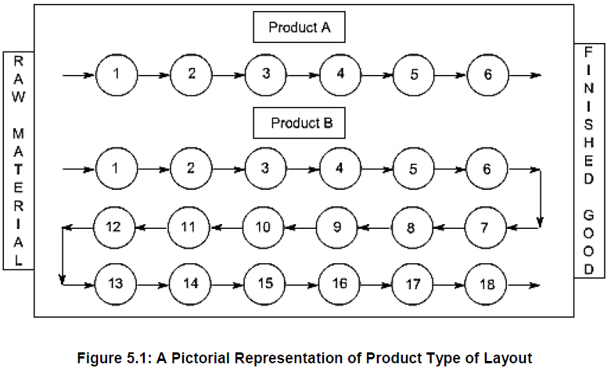
1. Product or Line Layout
This type of layout is generally used in systems where a product has to be manufactured or assembled in large quantities. In product layout the machinery and auxiliary services are located according to the processing sequence of the product without any buffer storage within the line itself.

Slide 7
2. Process or Functional Layout
In a process layout, (also referred to as a job shop layout) similar machines and services are located together. Therefore, in a process type of layout all drills are located in one area of the layout and all milling machines are located in another area. A manufacturing example of a process layout is a machine shop. Process layouts are also quite common in non-manufacturing environments. Examples include hospitals, colleges, banks, auto repair shops, and public libraries.

Slide 8
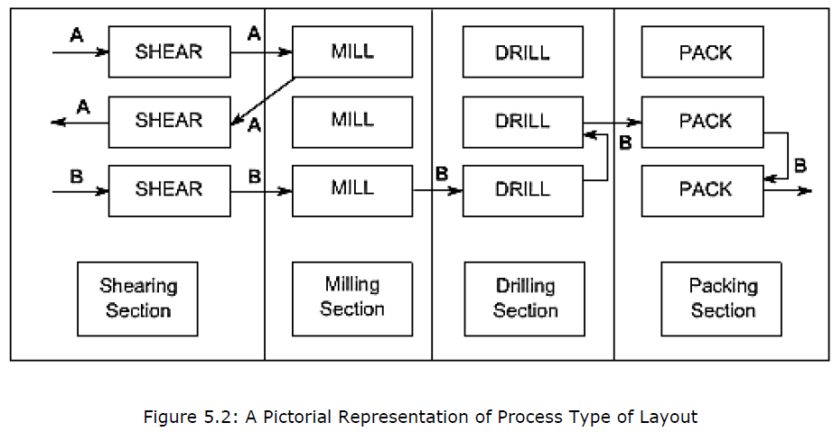

Slide 9
3. Process or Functional Layout
n this type of layout, the product is kept at a fixed position and all other material; components, tools, machines, workers, etc. are brought and arranged around it. Then assembly or fabrication is carried out. The layout of the fixed material location department involves the sequencing and placement of workstations around the material or product. It is used in aircraft assembly, shipbuilding, and most construction projects.

Slide 10
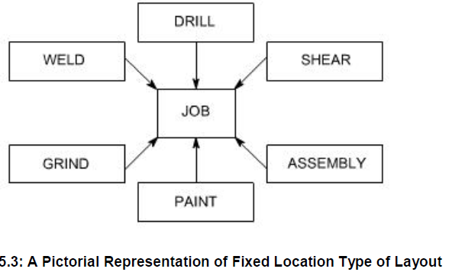

Slide 11
4. Combination Layout:
It is a combination of process and product layouts combines the advantages of both types of layouts.
A combination layout is possible where an item is being made in different types and sizes. Here machinery is arranged in a process layout but the process grouping is then arranged in a sequence to manufacture various types and sizes of products.
It is to be noted that the sequence of operations remains same with the variety of products and sizes. The following figure shows a combination type of layout for manufacturing different sized gears.

Slide 12
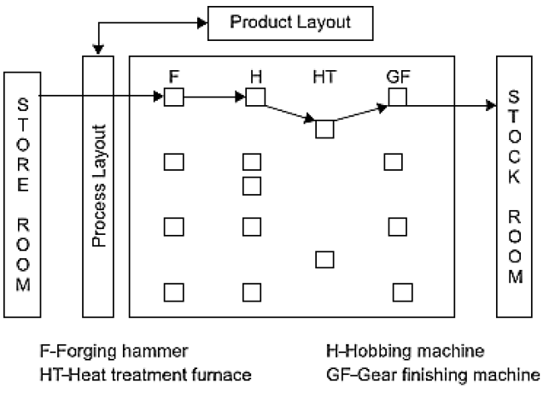

Slide 13
Assembly Line Balancing
Assembly line balancing is a production strategy that sets an intended rate of production to produce a particular product within a particular time frame. Also, the assembly line needs to be designed effectively and tasks needs to be distributed among workers, machines and work stations ensuring that every line segments in the production process can be met within the time frame and available production capacity.
Assembly line balancing can also be defined as assigning proper number of workers or machines for each operations of an assembly line so as to meet required production rate with minimum or zero ideal time.
The very purpose of line balancing is to assign workloads to each assigned work station in a manner that the every works stations has approximately same amount of work to be done.

Slide 14
Benefits of Assembly Line Balancing in organization:
Improved process efficiency
Increased production rate
Reduced total processing time
Minimum or Zero Ideal Time
Potential increase in profits and decrease in costs

Slide 15
Materials handling
It can be also defined as ‘the function dealing with the preparation, placing and positioning of materials to facilitate their movement or storage ’.
Material handling is the art and science involving the movement, handling and storage of materials during different stages of manufacturing.
Material handling in Indian industries accounts for nearly 40% of the cost of production. Out of the total time spent for manufacturing a product, 20% of the time is utilized for actual processing on them while the remaining 80% of the time is spent in moving from one place to another, waiting for the processing.

Slide 16
Objectives of materials handling
Reduced costs,
Increased capacity,
Improved working conditions,
Improved customer service, and
Improved productivity

Slide 17
Principles of Material handling
Planning principle: All handling activities should be planned.
Systems principle: Plan a system integrating as many handling activities as possible and co-coordinating the full scope of operations (receiving, storage, production, inspection, packing, warehousing, supply and transportation).
Space utilization principle: Make optimum use of cubic space.
Unit load principle: Increase quantity, size, weight of load handled.
Gravity principle: Utilize gravity to move a material wherever practicable.
Material flow principle: Plan an operation sequence and equipment arrangement to optimize material flow.

Slide 18
Principles of Material handling
Simplification principle: Reduce combine or eliminate unnecessary movement and/or equipment.
Safety principle: Provide for safe handling methods and equipment.
Mechanization principle: Use mechanical or automated material handling equipment.
Standardization principle: Standardize method, types, size of material handling equipment.
Flexibility principle: Use methods and equipment that can perform a variety of taskand applications.
Equipment selection principle: Consider all aspect of material, move and method to be utilized.

Slide 19
Principles of Material handling
Dead weight principle: Reduce the ratio of dead weight to pay load in mobile equipment.
Motion principle: Equipment designed to transport material should be kept in motion.
Idle time principle: Reduce idle time/unproductive time of both MH equipment and man power.
Maintenance principle: Plan for preventive maintenance or scheduled repair of all handling equipment.
Performance principle: Determine efficiency of handling performance in terms of cost per unit handled which is the primary criterion.

Slide 20
Types of Material Handling Devices
Storage and Handling Equipment
Engineered Systems
Industrial Trucks
Bulk Material Handling Equipment

Slide 21
Storage and Handling Equipment
Storage equipment is usually limited to non-automated examples, which are grouped in with engineered systems.
Storage equipment is used to hold or buffer materials during “downtimes,” or times when they are not being transported.
These periods could refer to temporary pauses during long-term transportation or long-term storage designed to allow the buildup of stock.
The majority of storage equipment refers to pallets, shelves or racks onto which materials may be stacked in an orderly manner to await transportation or consumption.

Slide 22
Examples of storage and handling equipment include:
Racks, such as pallet racks, drive-through or drive-in racks, push-back racks, and sliding racks.
Stacking frames
Shelves, bins and drawers
Mezzanines

Slide 23
Engineered Systems
Engineered systems cover a variety of units that work cohesively to enable storage and transportation. They are often automated. A good example of an engineered system is an Automated Storage and Retrieval System, often abbreviated AS/RS, which is a large automated organizational structure involving racks, aisles and shelves accessible by a “shuttle” system of retrieval.
Other types of engineered systems include:
Conveyor systems
Robotic delivery systems
Automatic guided vehicles (AGV)

Slide 24
Industrial Trucks
Industrial trucks refer to the different kinds of transportation items and vehicles used to move materials and products in materials handling. These transportation devices can include small hand-operated trucks, pallet-jacks, and various kinds of forklifts. These trucks have a variety of characteristics to make them suitable for different operations. Some trucks have forks, as in a forklift, or a flat surface with which to lift items, while some trucks require a separate piece of equipment for loading. Trucks can also be manual or powered lift and operation can be walk or ride, requiring a user to manually push them or to ride along on the truck. A stack truck can be used to stack items, while a non-stack truck is typically used for transportation and not for loading.

Slide 25
There are many types of industrial trucks:
Hand trucks
Pallet jacks
Pallet truck
Walkie stackers
Platform trucks
Order picker
Side loader
Many types of AGV

Slide 26
Bulk Material Handling Equipment
Bulk material handling refers to the storing, transportation and control of materials in loose bulk form.
These materials can include food, liquid, or minerals, among others. Generally, these pieces of equipment deal with the items in loose form, such as conveyor belts or elevators designed to move large quantities of material, or in packaged form, through the use of drums and hoppers.

Slide 27
Examples
Conveyor belt
Stackers
Reclaimers
Bucket elevators
Grain elevators
Hoppers
Silos

Slide 28
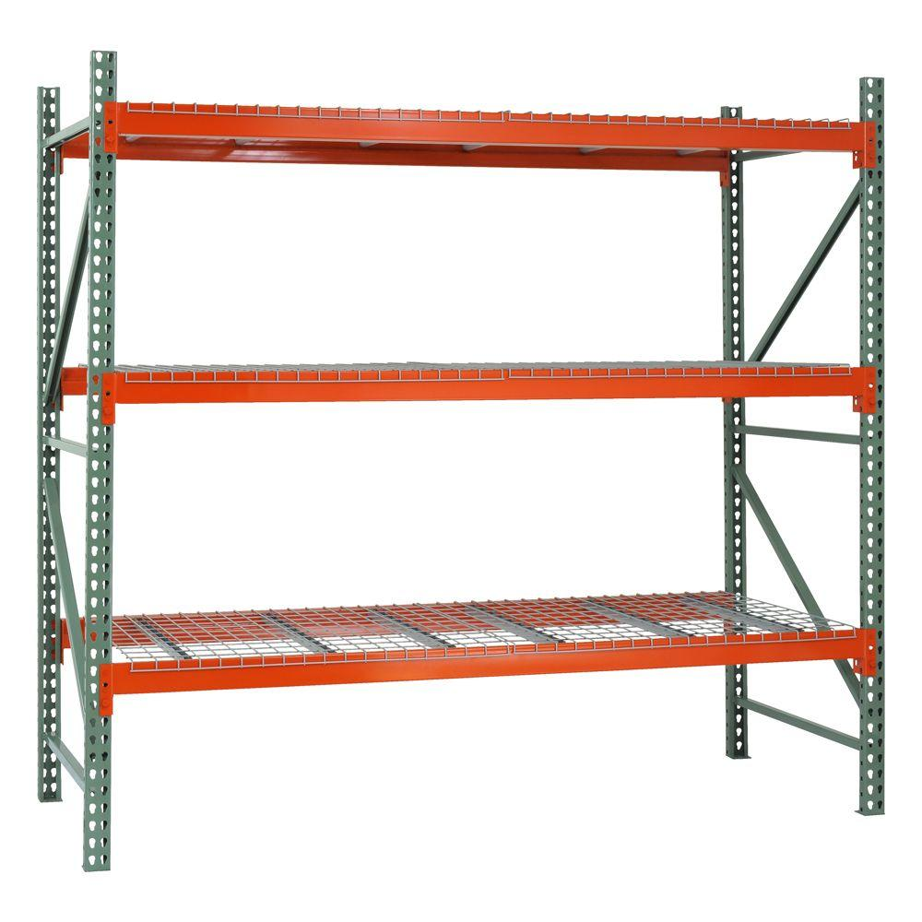
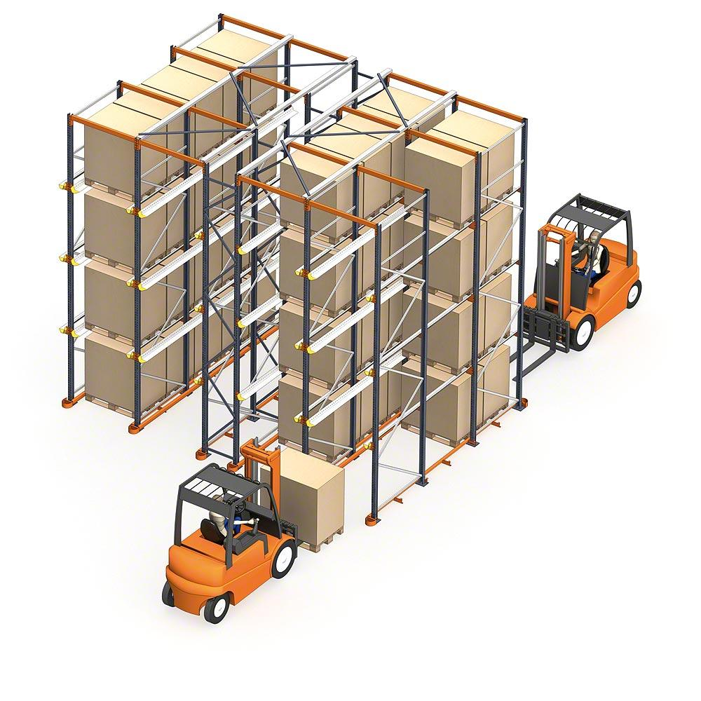
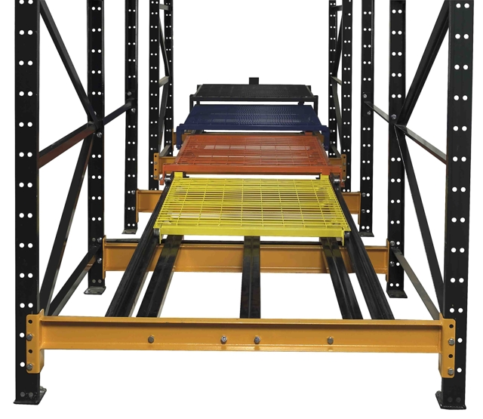
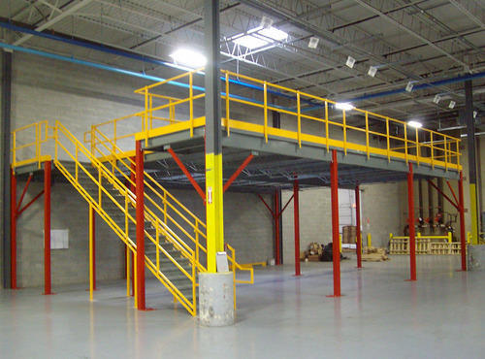
Pallets rack
Drive in through racks
Push back
mezzanines

Slide 29
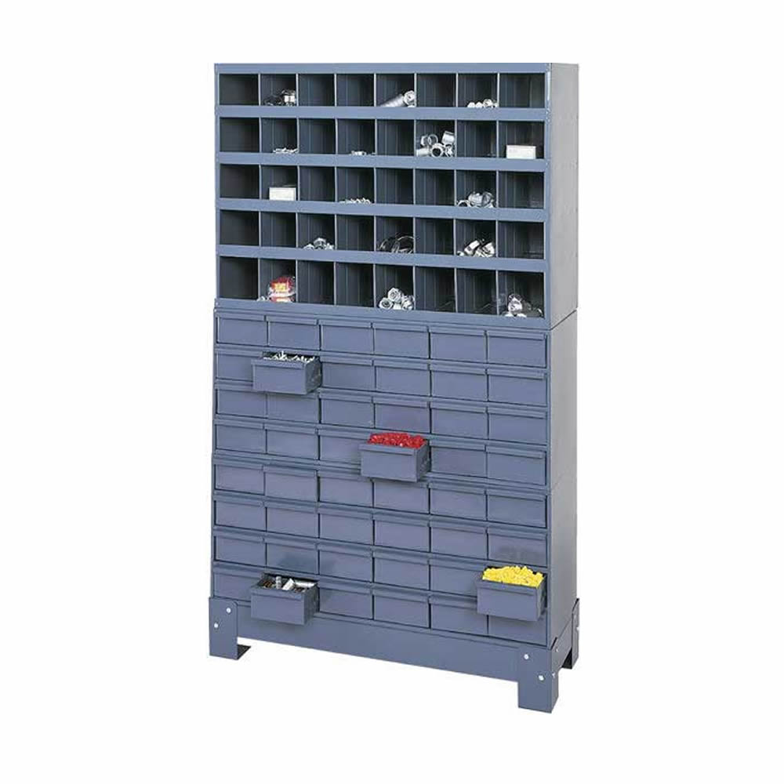
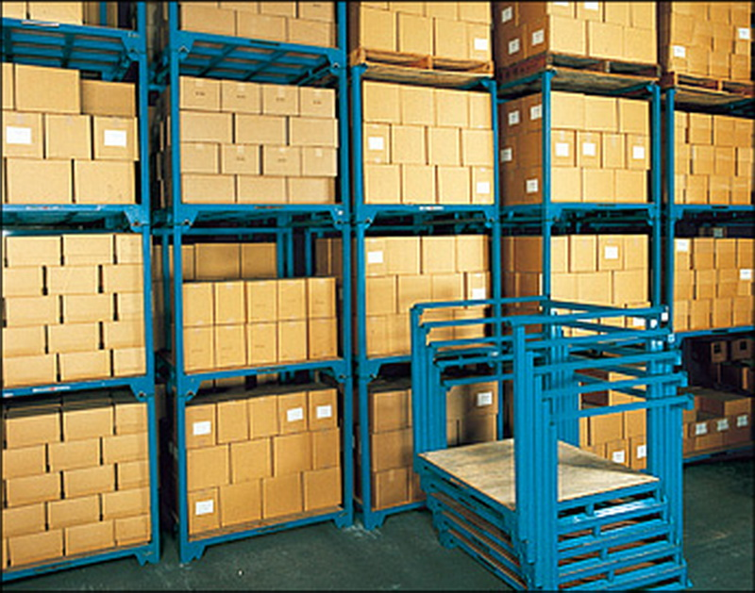
Bins and Drawers
Stacking frames

Slide 30
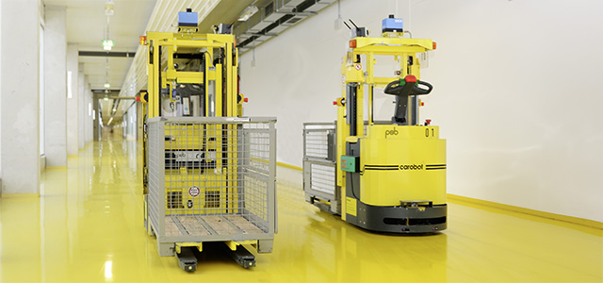
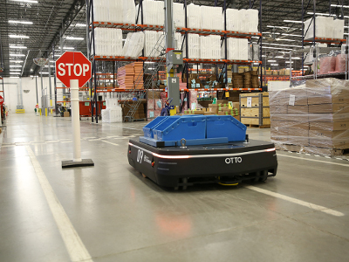
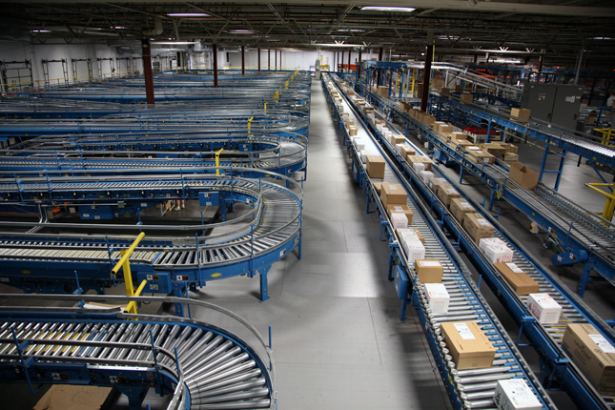
AGV
Robot system
Conveyor system

Slide 31
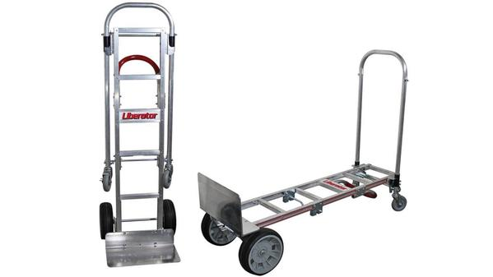
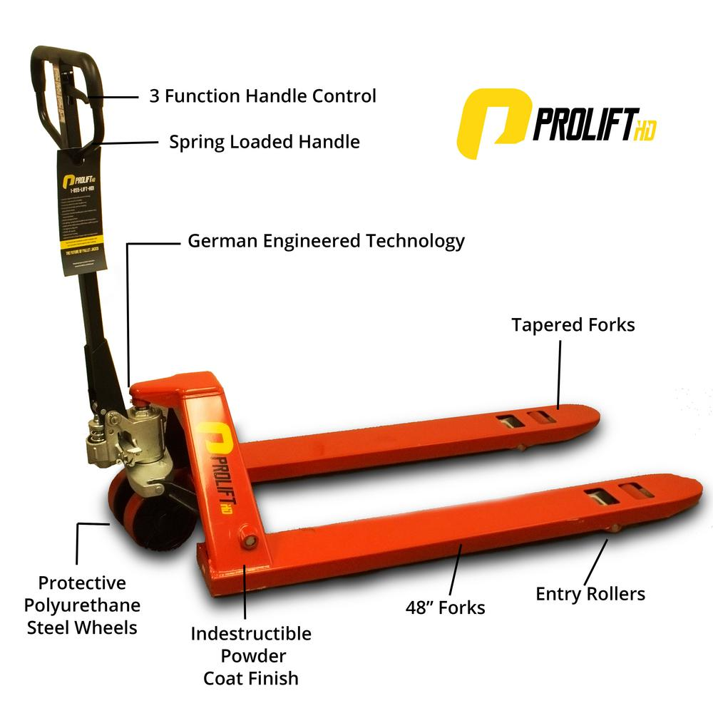
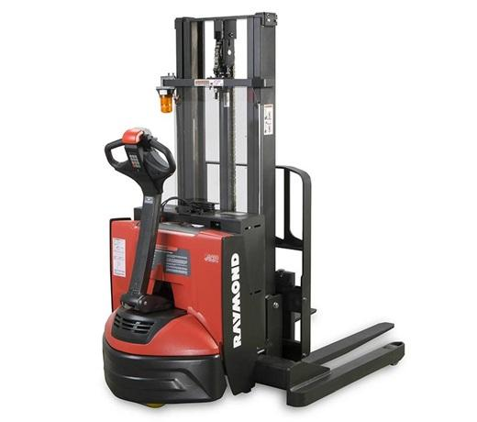
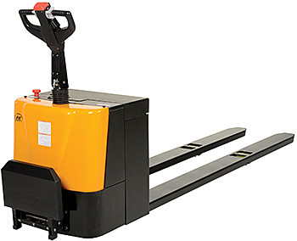
Pallet Jack
Hand Truck
Walkie Stacker

Slide 32
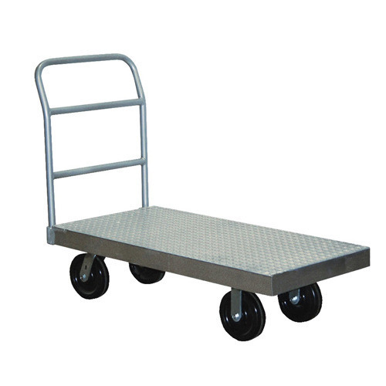
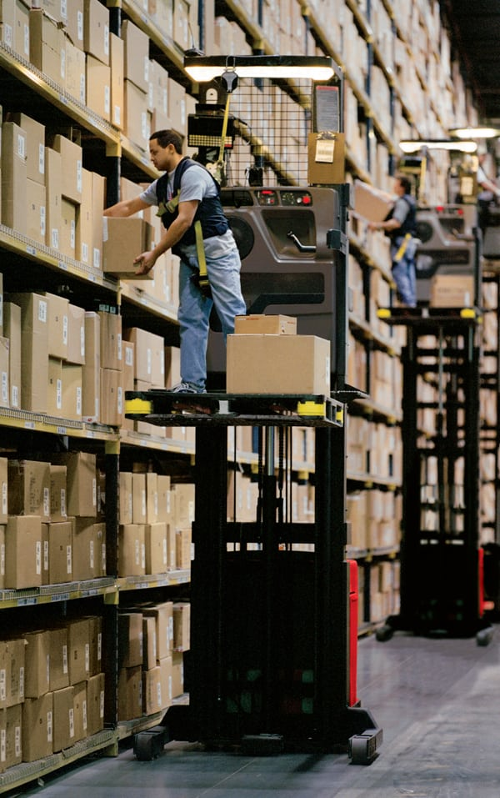
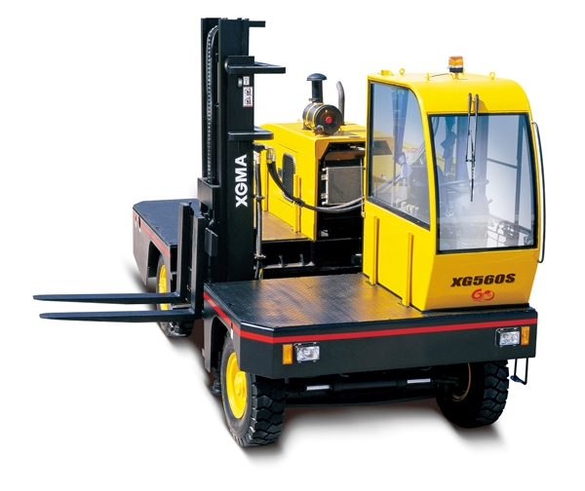
Order Picker
Platform Truck
Sideloader

Slide 33
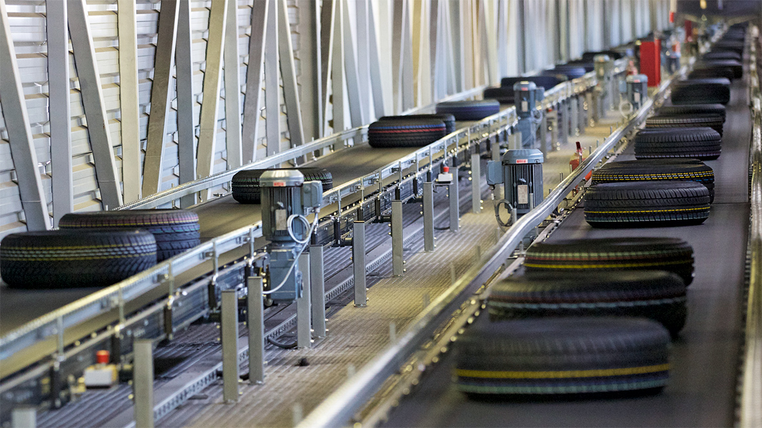
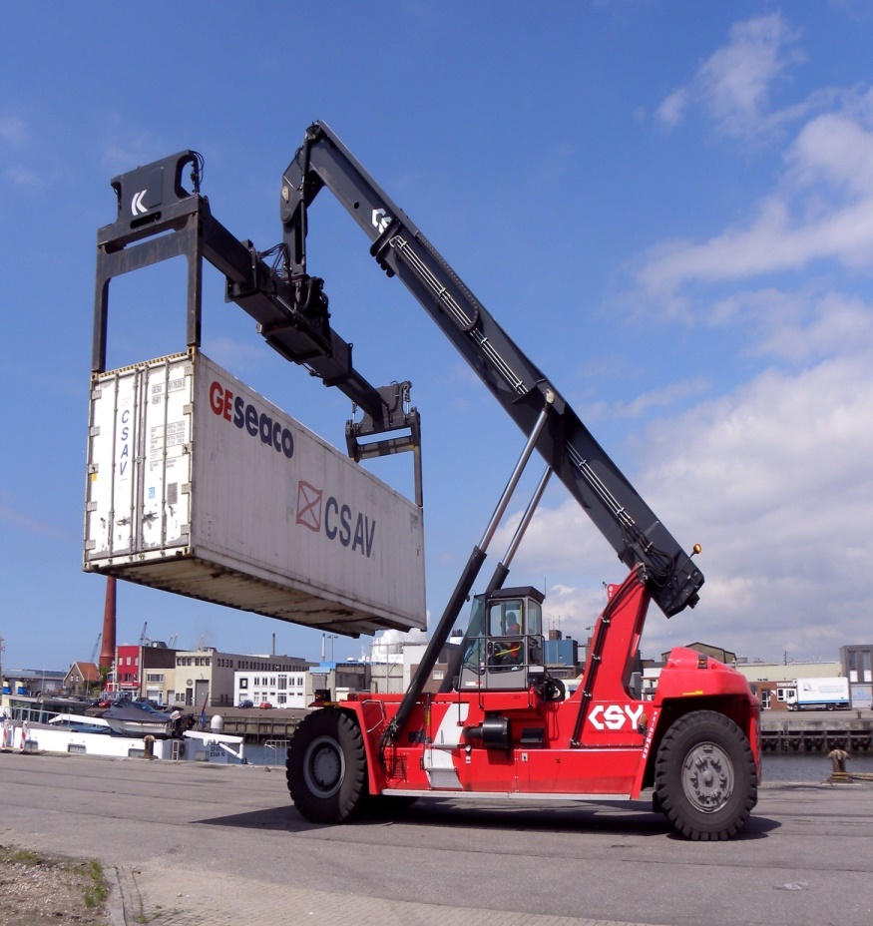
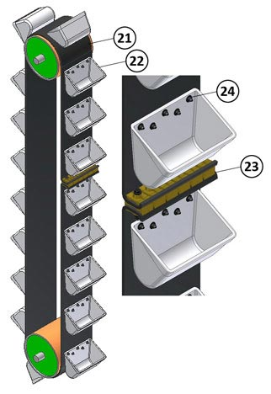
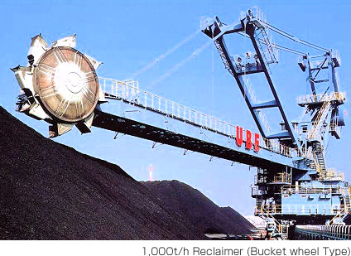
Stacker
Conveyor belts
Bucket elevator
Reclaimer

Slide 34
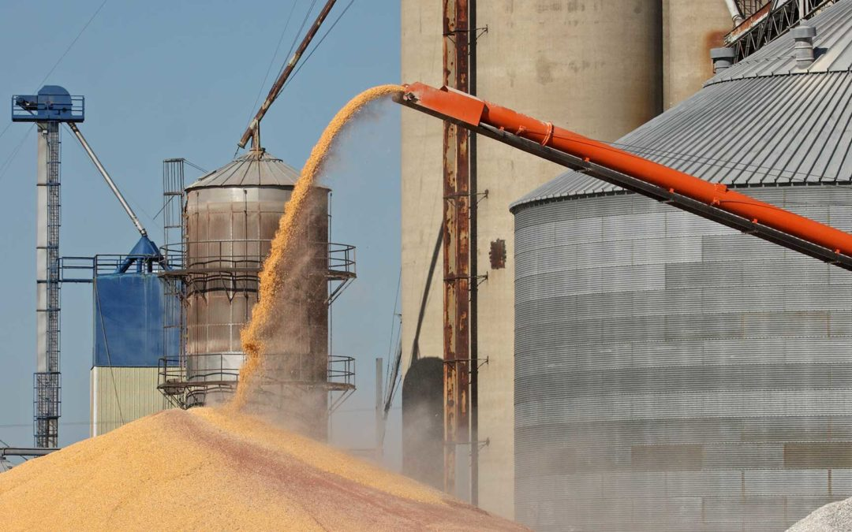
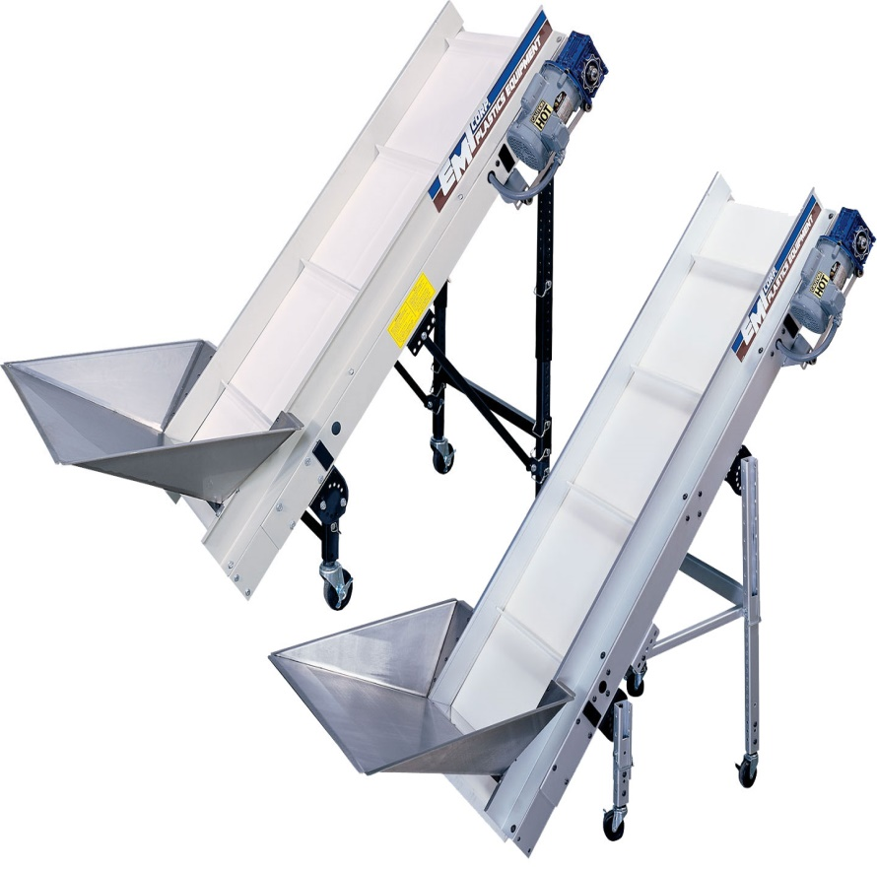
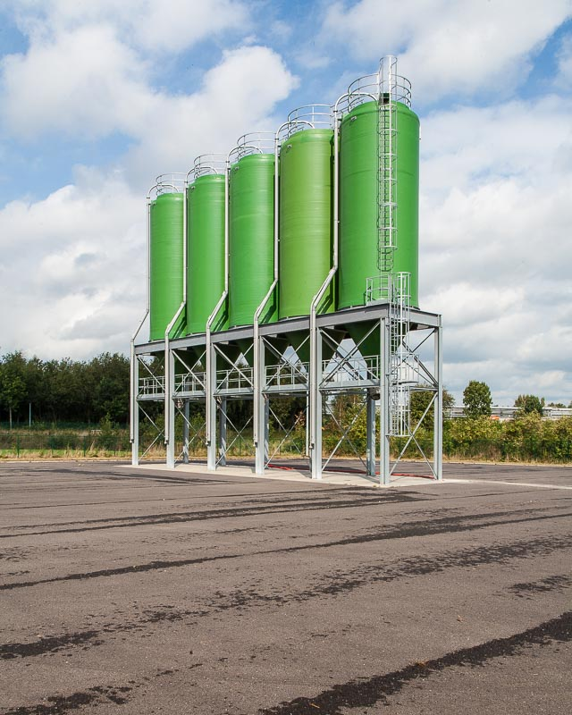
Elevator with Hopper
Grain elevator
Silos

